Slide 1
Data Analysis for Adult Data
Can Song

Slide 2
Outline
Data Wrangling
Missing values
Duplicated values
Others
Data Exploration
Correlation
Distribution
Data Mining

Slide 3
Data Wrangling
Missing value
In the form of “？”
7.3% in the training set，7.4% in the test
To conclude, delete records with missing values
Duplicated value
23 duplicated records
Cannot be identified as same person, and less in quantity, so these records will be kept
Others
No new factor level in test set
No duplicated factor level caused by typo

Slide 4
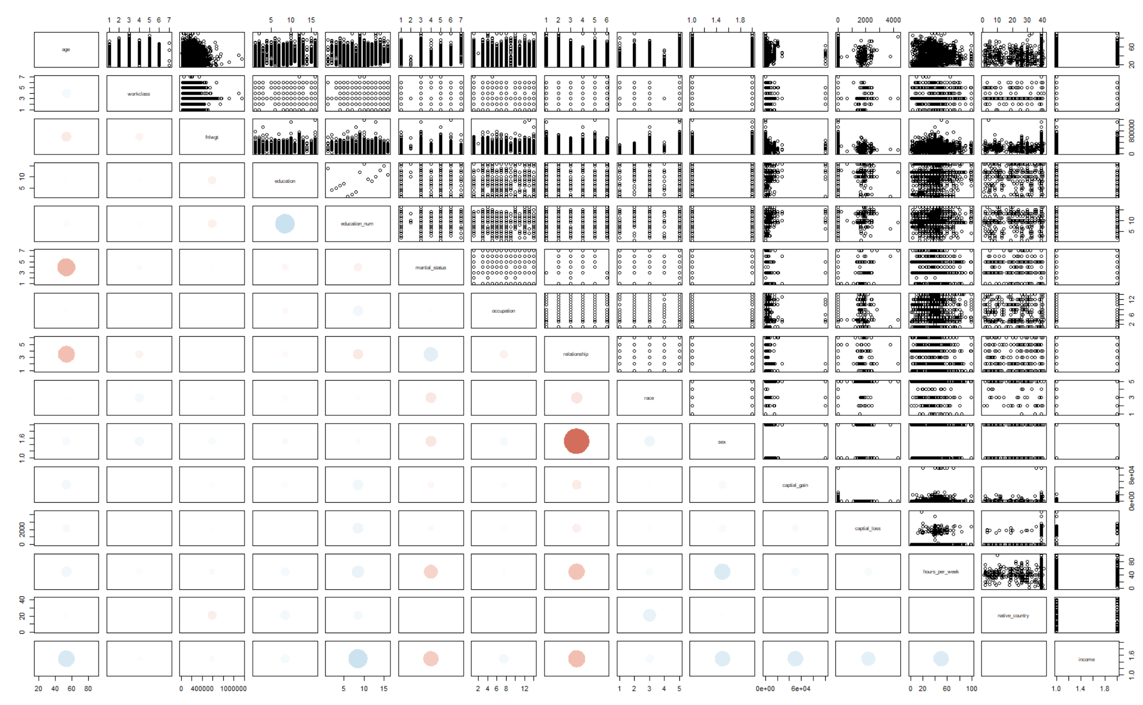
Data Exploration
Correlation
Highly correlated features

Slide 5
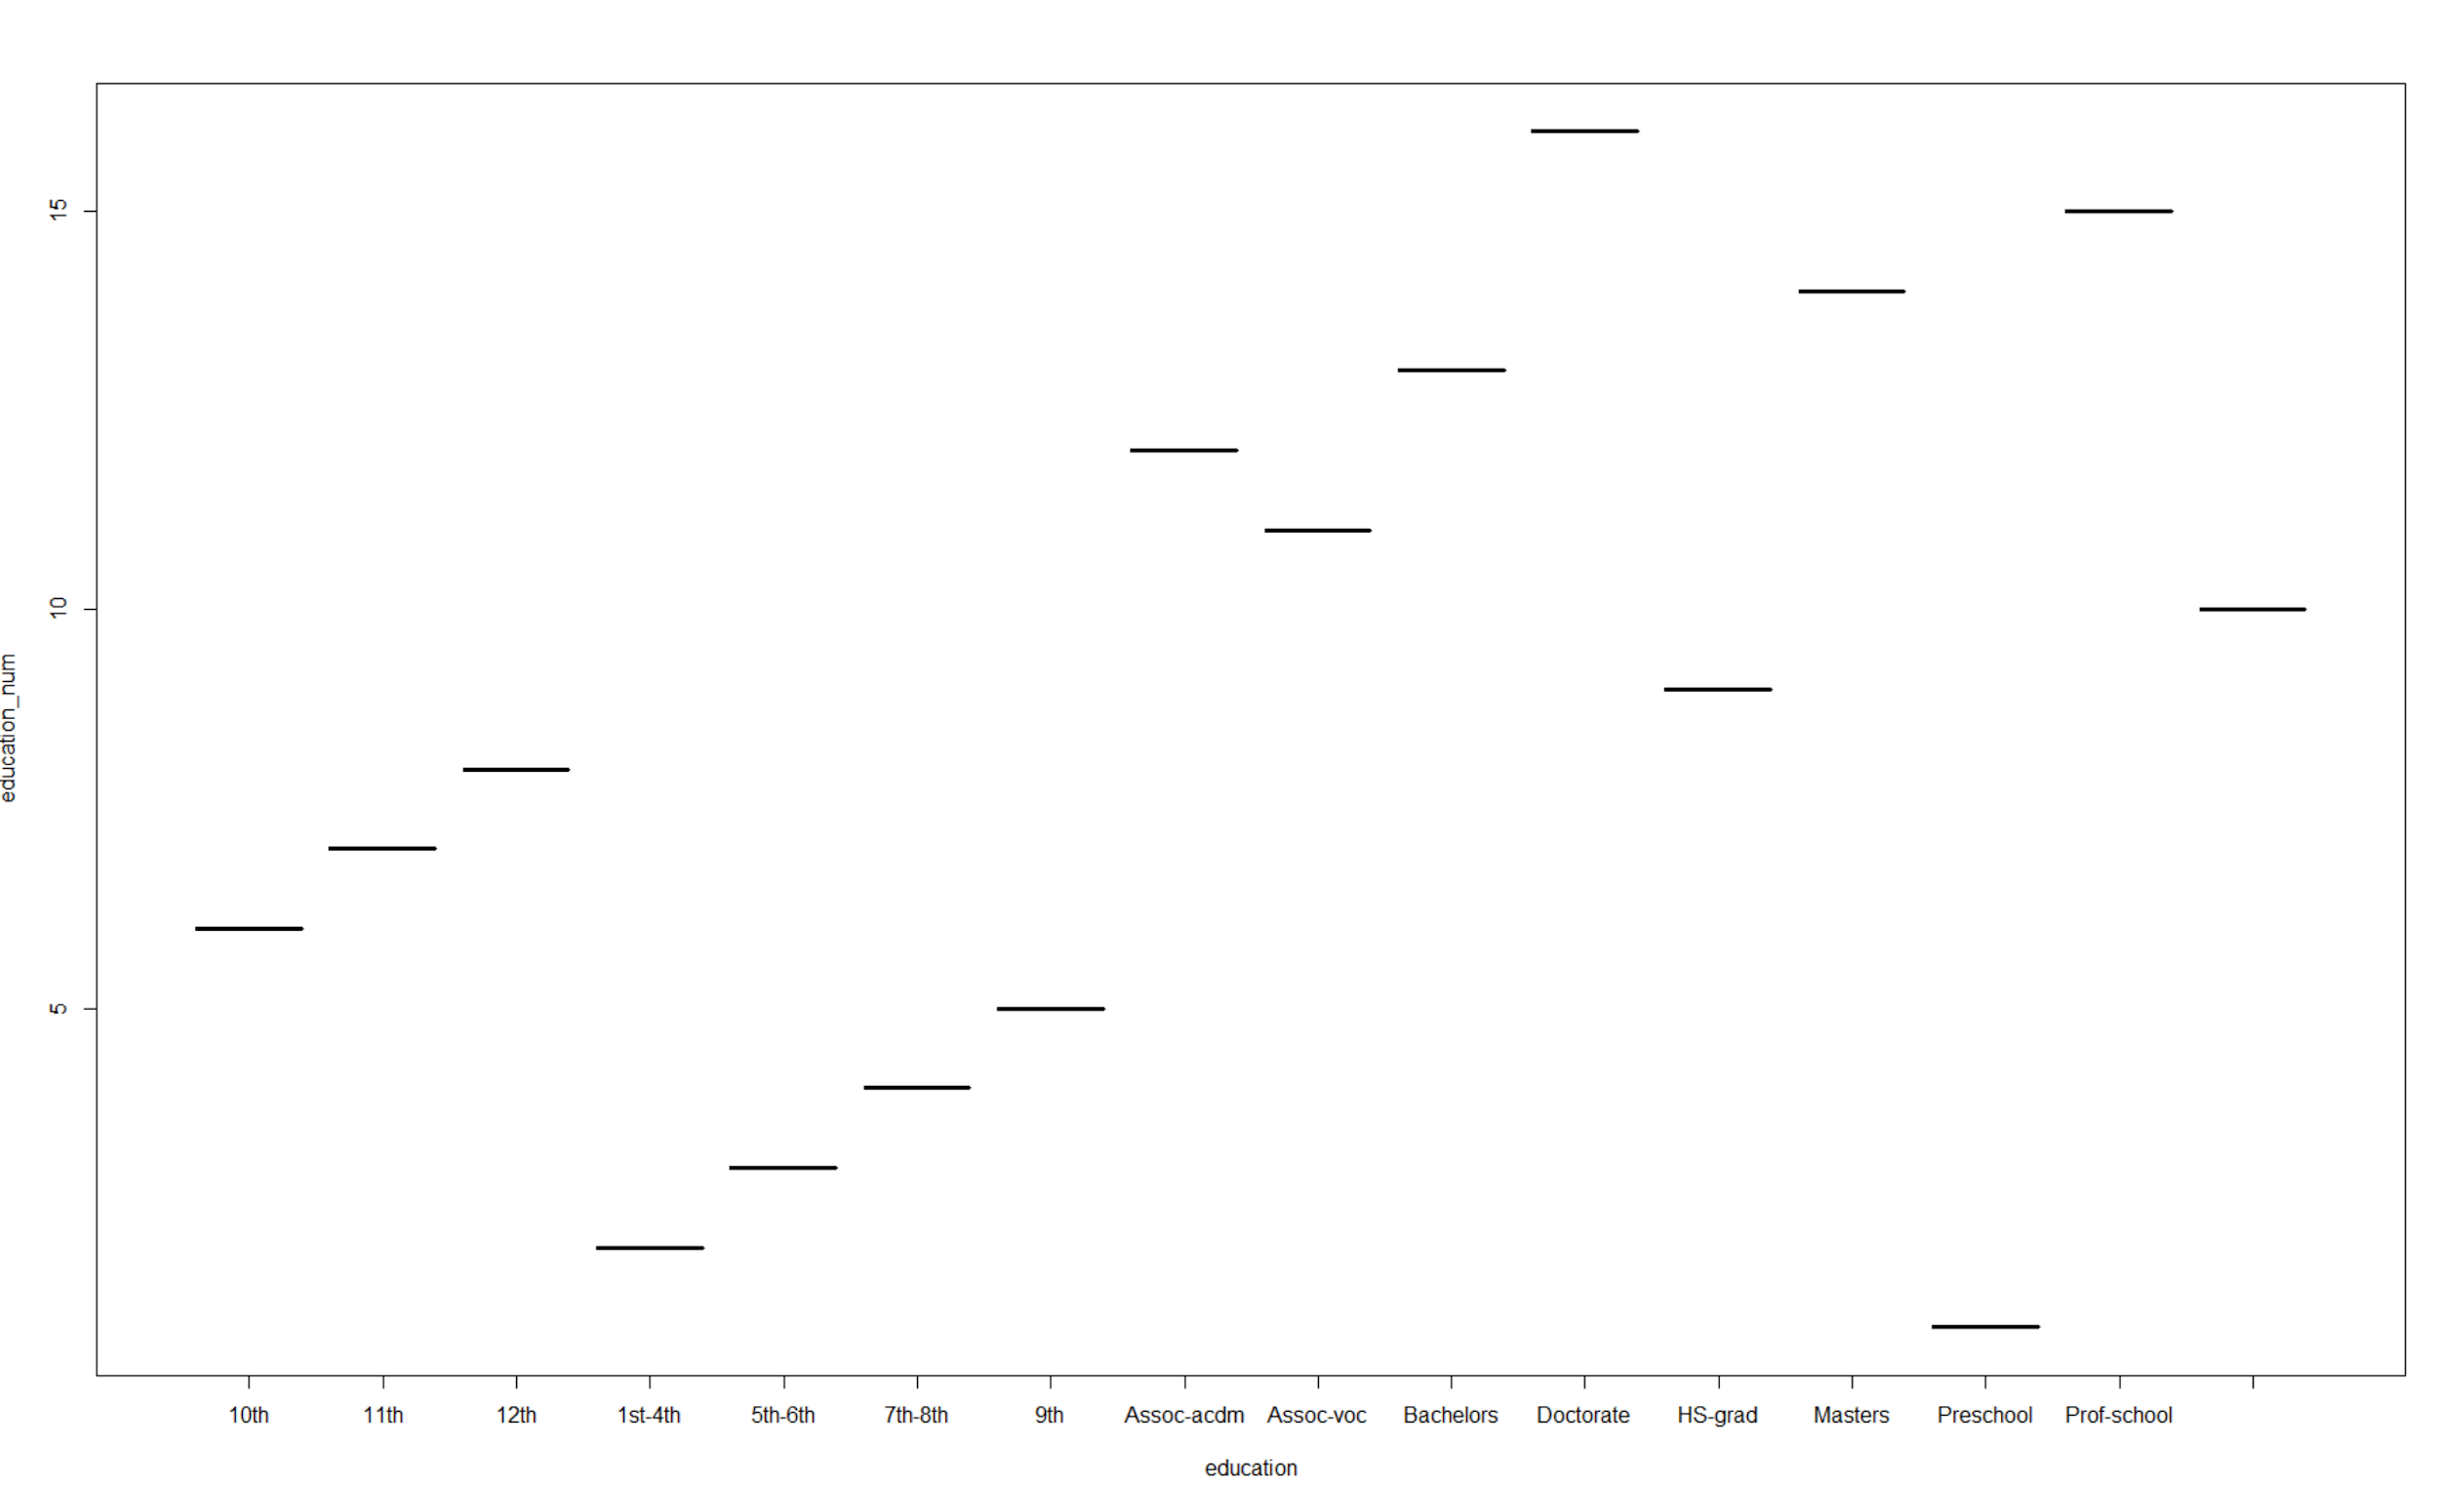
Data Exploration
Correlation
The values in Education and values in education_num mean the same things respectively, and Education level is superimposed, so the education_num will be kept

Slide 6
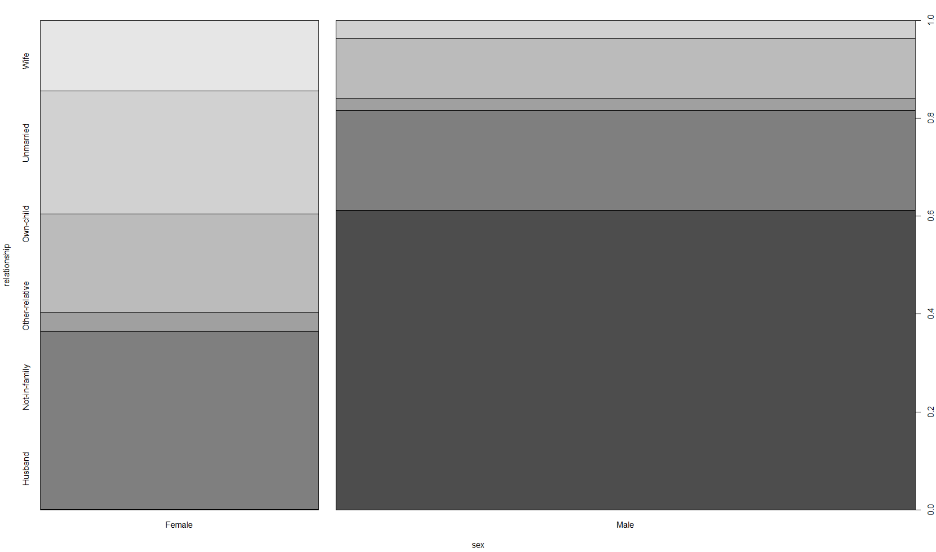
Data Exploration
Correlation
Although relevant, but not the same, so keep both

Slide 7
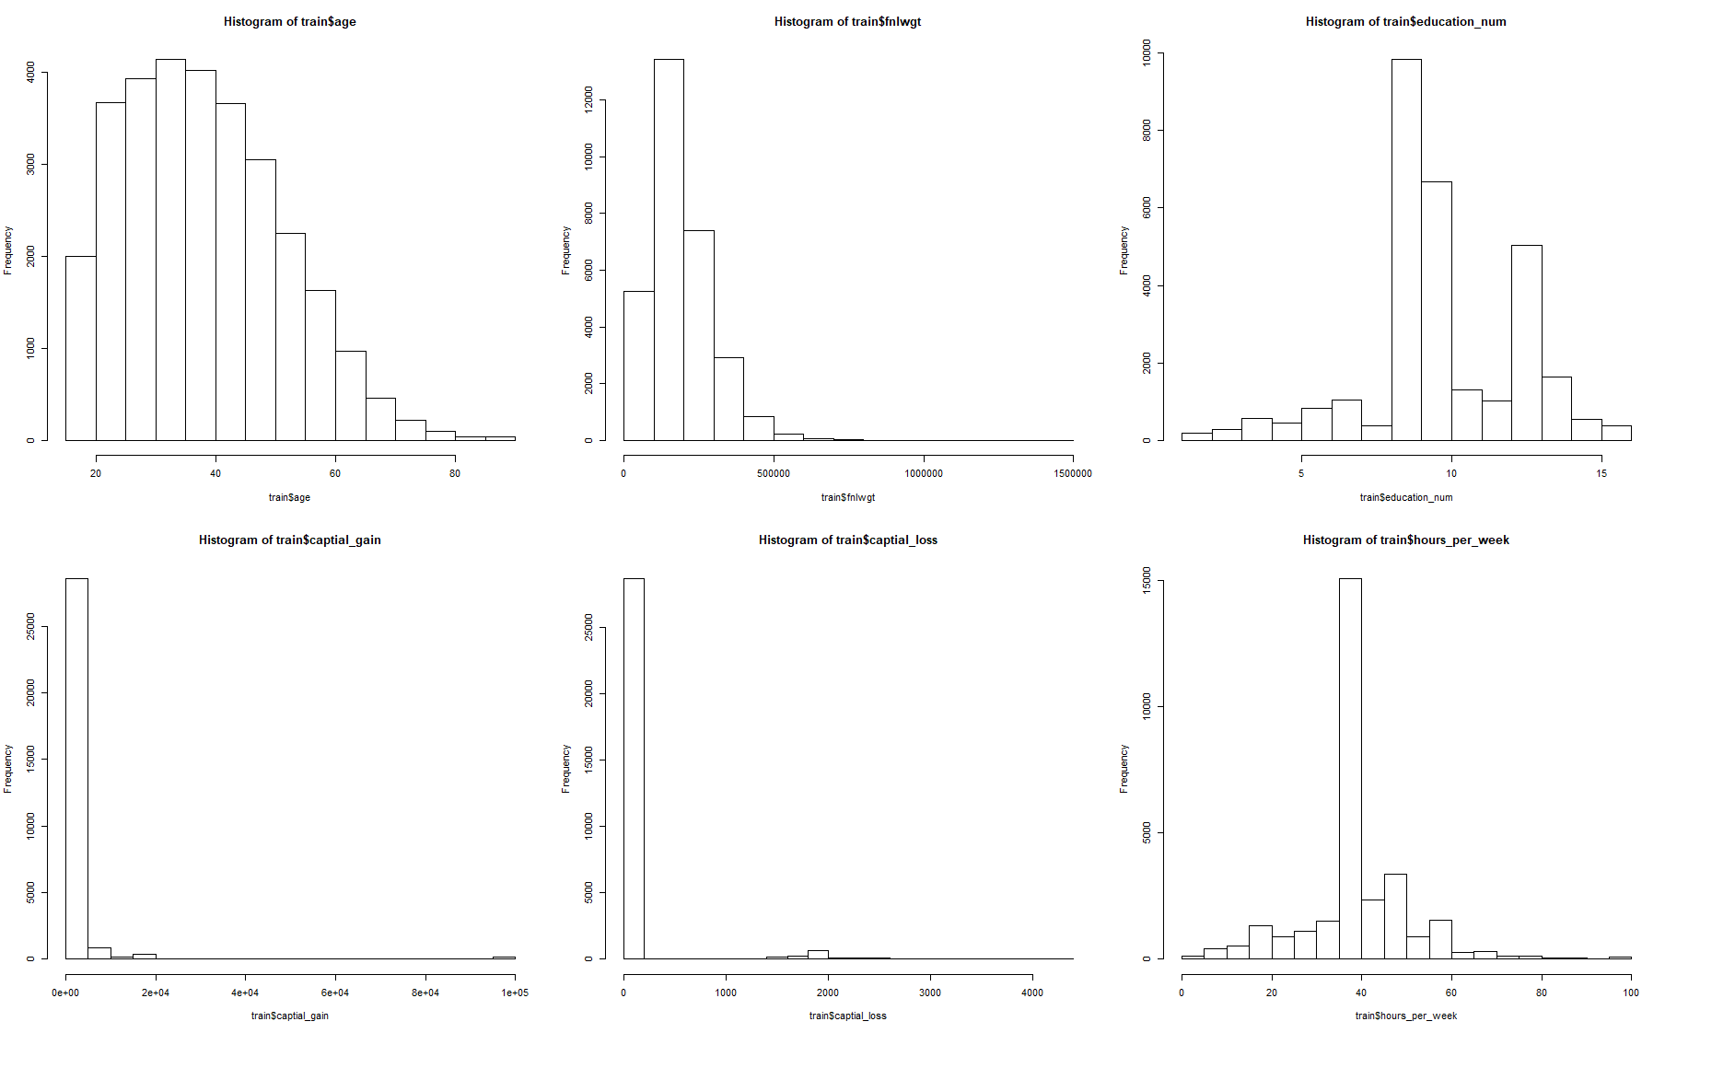
Data Exploration
Distribution
The distribution of numerous features:
Most are skewed distribution but some like education number and hours_per_week are like normal distribution

Slide 8
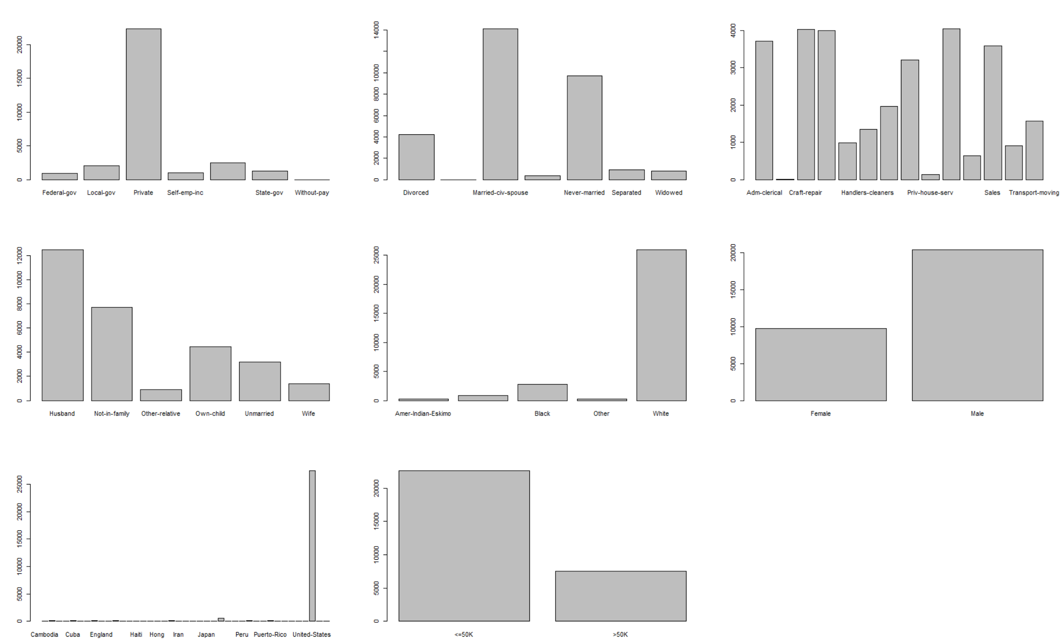
Data Exploration
Distribition
The distribution of categorical features:
not distributed evenly

Slide 9
Data Mining
Logistic Regression
Reason
Binary Classification
Categorical features - treated as dummy variable
Less indenpendence in features
Sufficient sample size
Maximum likelihood could suppress the effects of abnormal, resulting in decrease the influences of skewed distributed features
Easy to understand

Slide 10
Data Mining
Logistic Regression
2. Model: glm using all features
Most significant features: age, workclass Self-emp-not-inc, education_num, occupation Exec-managerial， relationship Wife, sex male, capital_gain, capital_loss, hours_per_week
All numerous features are significant
All categorical features are significant
Coefficients: taking age for example, when age increase one unit, the log odds will increase 0.02634
Siginificant difference with Null Model
Every features has significant influences to decrease deviance of residuals
To conclude, the model fits the data very well

Slide 11
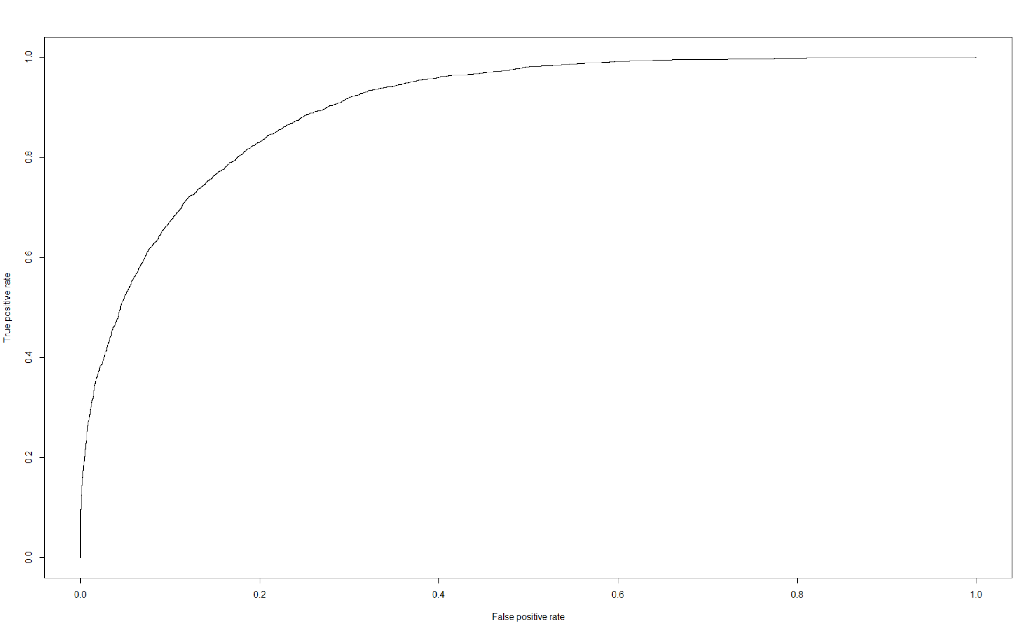
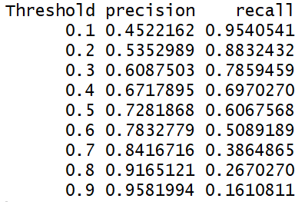
Data Mining
Logistic Regression
3. Test
Accuarcy：0.847; AUC = 0.902 （threshold = 0.5）
The precision and recall under different thresholds
Choose the suitable threshold according to the practical requirement and desire

